Slide 1
UNIT 7 Security in Cloud Computing
Prepared by
Er.Harendra Bikram Shah
(Lecturer)
Department of Computer Engineering

Slide 2
OUTLINES
Cloud Security Challenges
Dimensions of Cloud Security: Security and Privacy,
Compliance, and Legal or Contractual Issues,
Risk Management
Security Monitoring
Incident Response Planning
Security Architecture Design
Vulnerability Assessment
Data and Application Security
Virtual Machine Security
Handling Disasters management in Cloud.

Slide 3
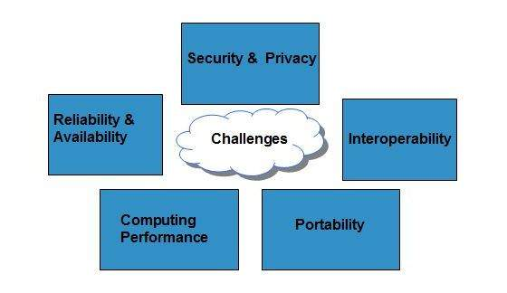
Cloud Computing Challenges

Slide 4
Cloud Security Challenges
Data Related Security
Data Breach
Data Lock in
Data Remanence
CSP level attacks
Guest hopping attack: Attack in one of the VM
SQL injection: Attacks at database level
Malicious Insider: Employee granted with full access
Application related security issues
Cloud malware injection attack
Cookie poisoning
Backdoor and Debug Option
Hidden Field Manipulation
Network level attacks
Domain hijacking: Changing the name of domain
Cross site scripting :Redirecting to other websites
DOS attack :Denial of Service

Slide 5
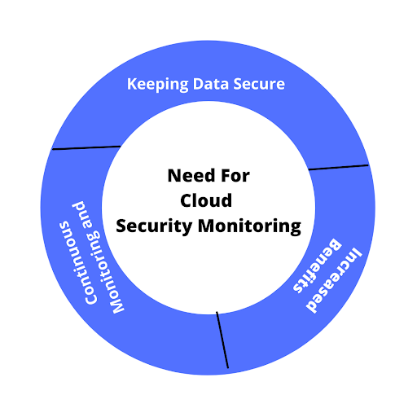
Security Monitoring in Cloud
It is the process of protecting the data stored in the cloud from any unauthorized access.

Slide 6
Key Best Practices for Effective Cloud Security Monitoring
Strict Data Control
Securing the Code
Separating Crucial Metrics
Patch Management
Automation
Identity and Access Management
Data Protection

Slide 7
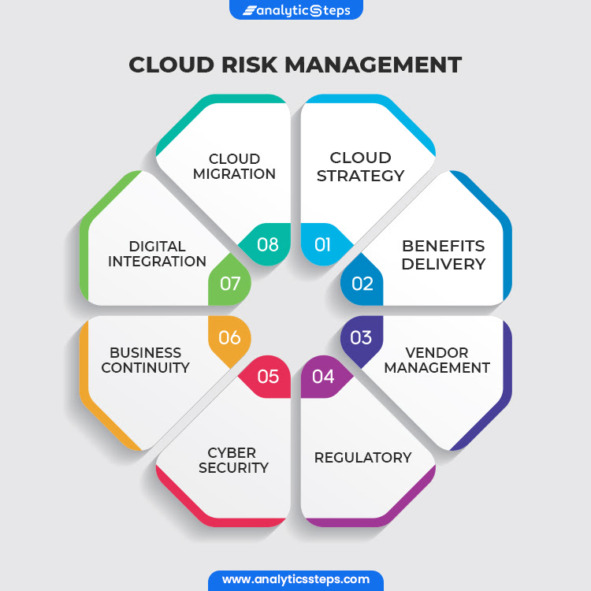
Cloud Risk Management

Slide 8
Legal or compliance issues in cloud
Contract documents
Service description
Service levels
Fees
Data protection
Data portability and backup
Security
Record keeping and audit rights
Compliance with laws
Intellectual property
Supplier liability for content
Liability under the contract
Variation of terms

Slide 9
CLOUD INCIDENT RESPONSE PLANNING
It is simply the process used to manage cyber attacks in a cloud environment
Incident Detection methods or techniques
Preparation
Detection and analysis
Containment, eradication, and recovery
Post-mortem
The incident response phases are:
Preparation
Identification
Containment
Eradication
Recovery
Lessons Learned

Slide 10
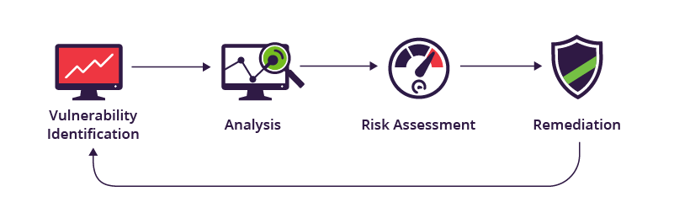
Vulnerability Assessment
It is a systematic review of security weaknesses in an information system.
Types of Vulnerability Assessment
Host assessment –
Network and wireless assessment –
Database assessment –
Application scans –.
Security scanning process

Slide 11
Data and Application Security
Data Security refers to the process of protecting data from unauthorized access and data corruption throughout its lifecycle
Cloud data security
Data Encryption
Hardware Security Module
Key Management
Enterprise Data Protection
Payment Security
Mobile app and web app security
Email Security
Cloud application security is a series of defined policies, processes, controls, and technology governing all information exchanges that happen in collaborative cloud environments.
Threats to Cloud Application Security
Misconfiguration of application setup .
Unauthorized access.
Insecure APIs and interfaces
Account hijacking

Slide 12
VM Security
virtual machine security means securing the guest OS like Physical OS
Security practices for VM’s Security
Protect the guest operating system
Disable unnecessary functionality
Use templates and scripted management
Minimize use of the virtual machine console
Consider UEFI(Unified Extensible Firmware Interface) secure boot]
Consider Carbon Black Cloud Workload

Slide 13
Handling Disasters management in Cloud
Disaster recovery (DR) is the process that goes into preparing for and recovering from a disaster.
Types of Disaster
Natural
Technical
Human
Methodologies of Disaster Management
Backup and Recovery
Pilot Light
Warm Standby
Multisite Deployment

Slide 14
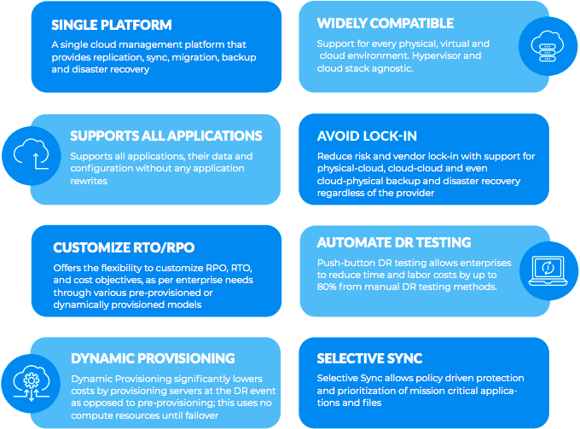
Rack ware Disaster Recovery Tool

Slide 15
END of UNIT 7

